Slide 1
Birth Death Process

Slide 2
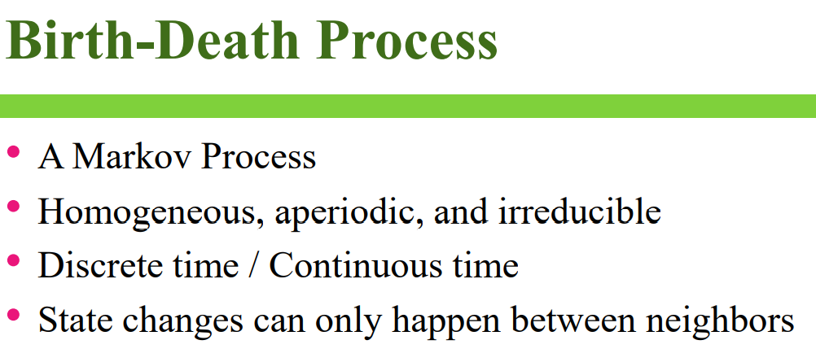

Slide 3
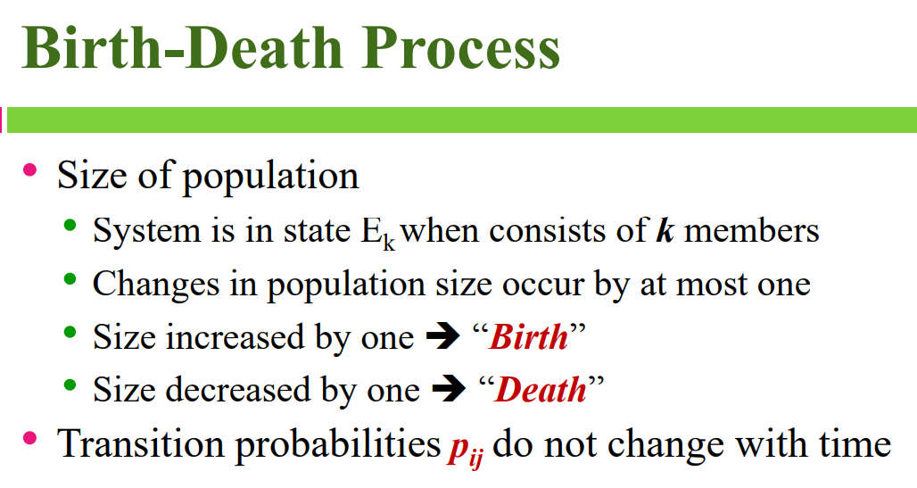

Slide 4
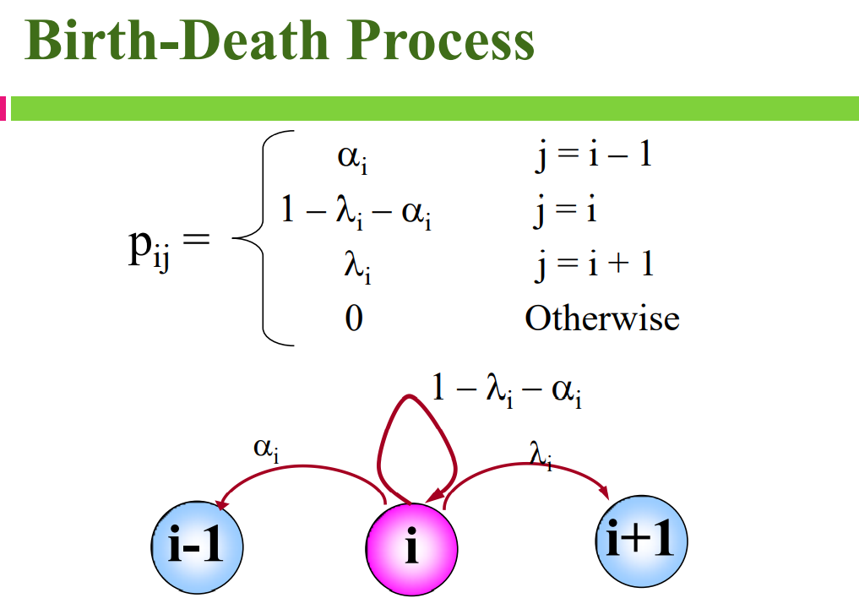

Slide 5
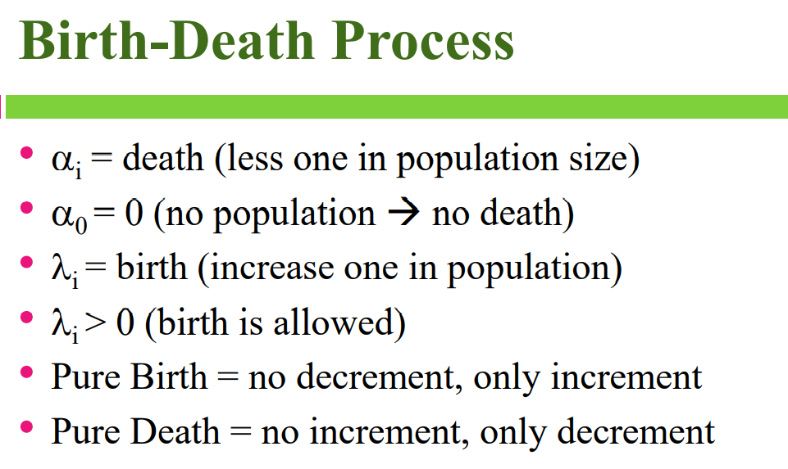

Slide 6
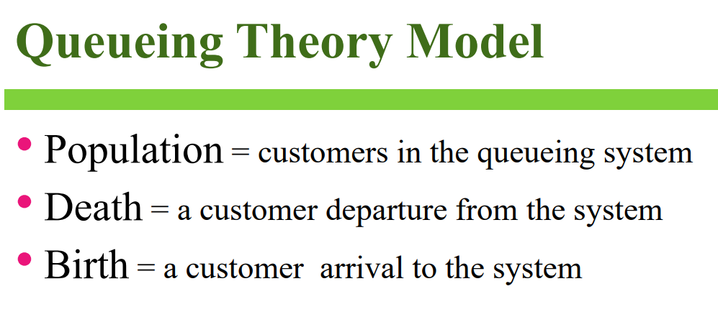

Slide 7
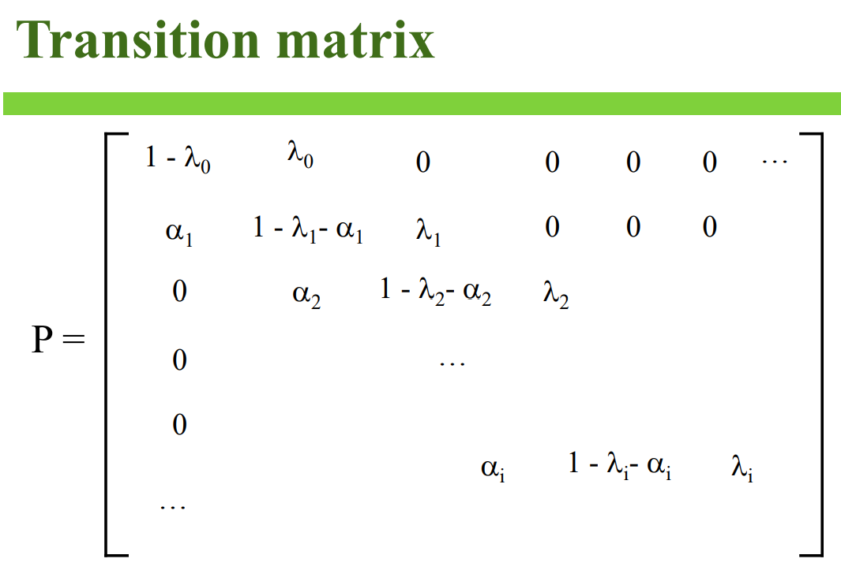

Slide 8
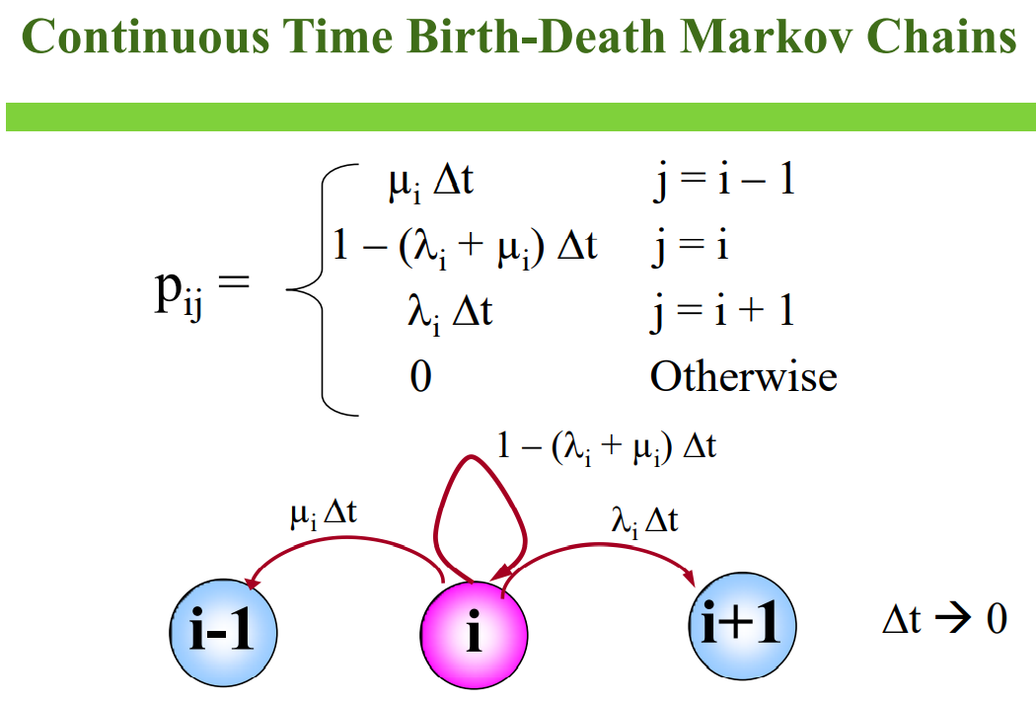

Slide 9
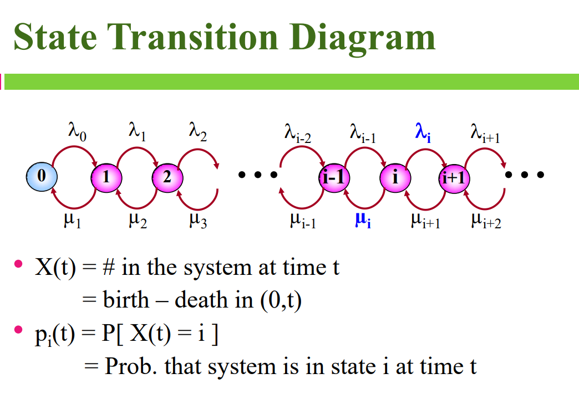

Slide 10
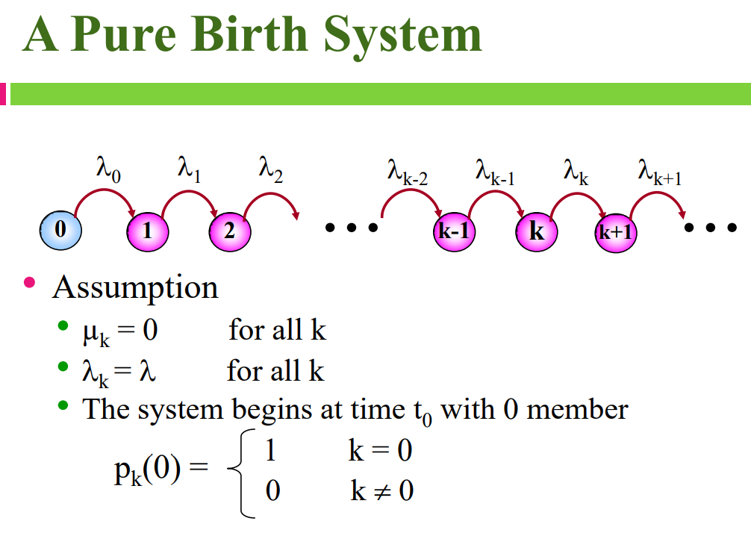

Slide 11
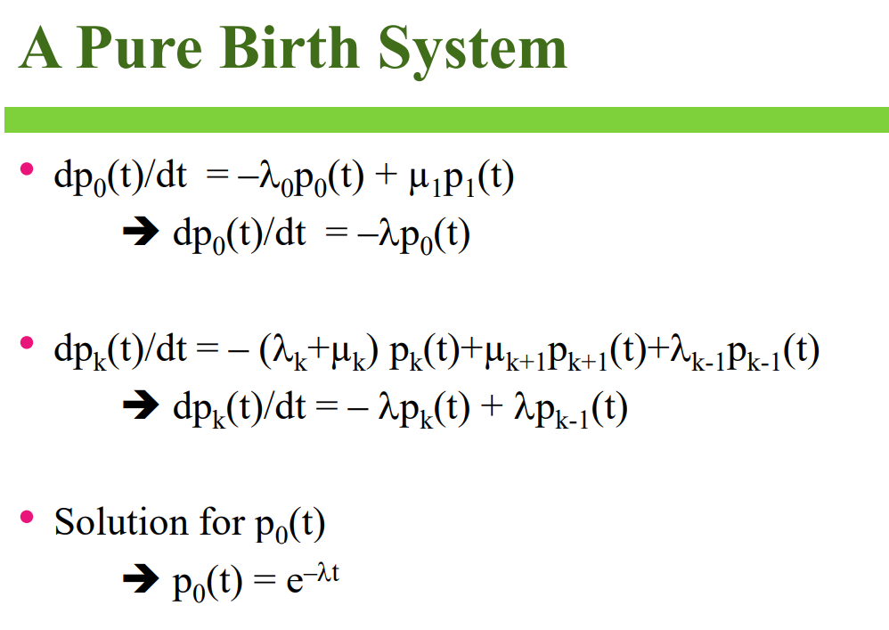

Slide 12
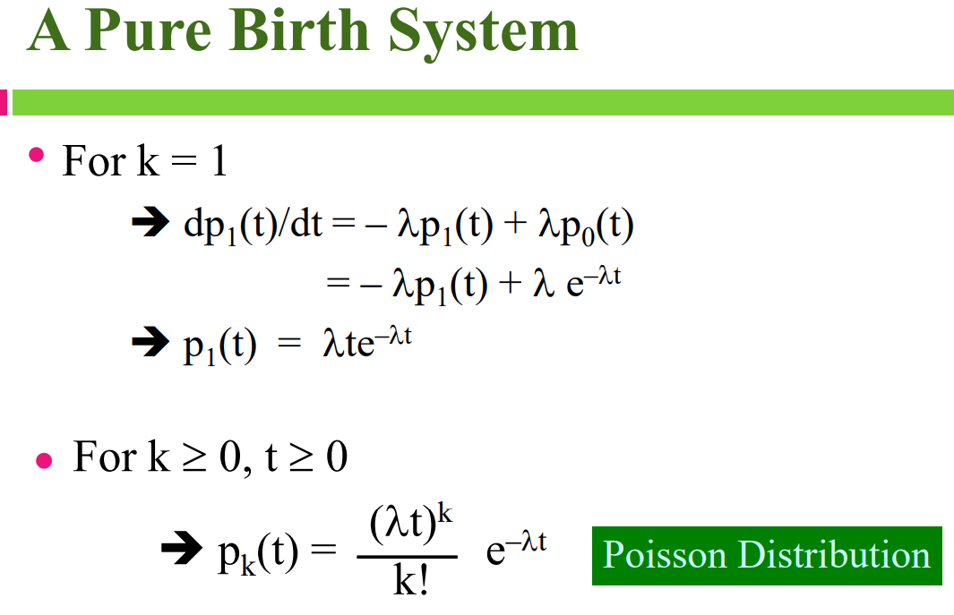
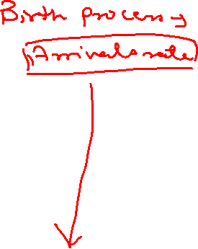

Slide 13
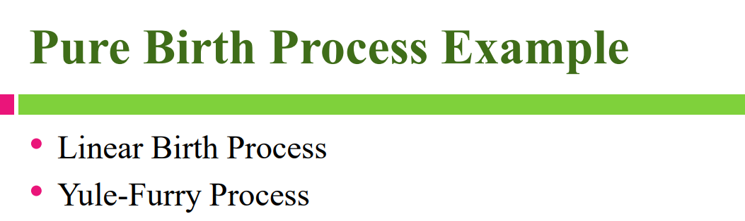

Slide 14
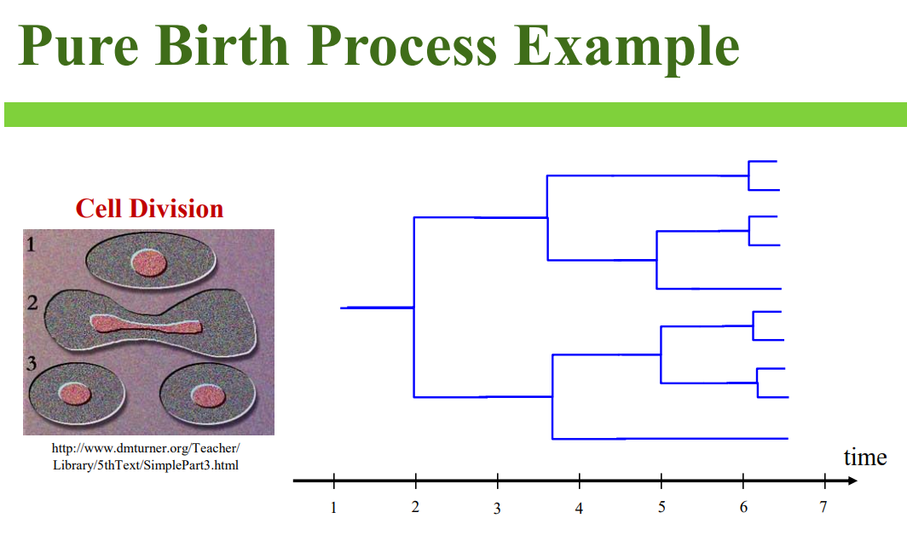

Slide 15
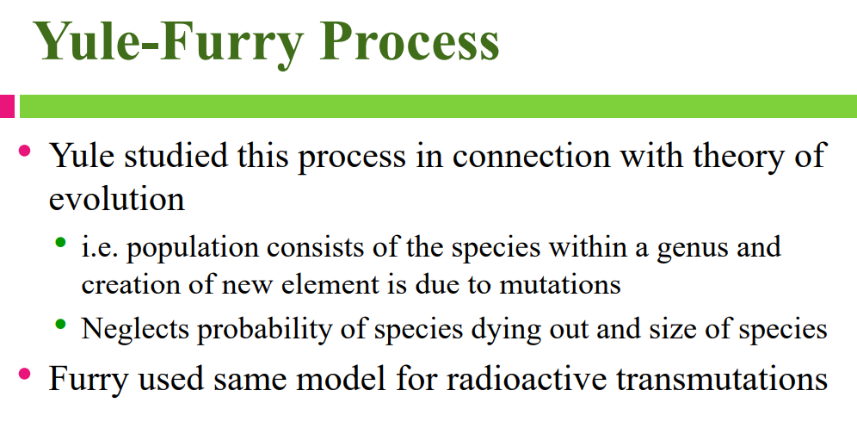
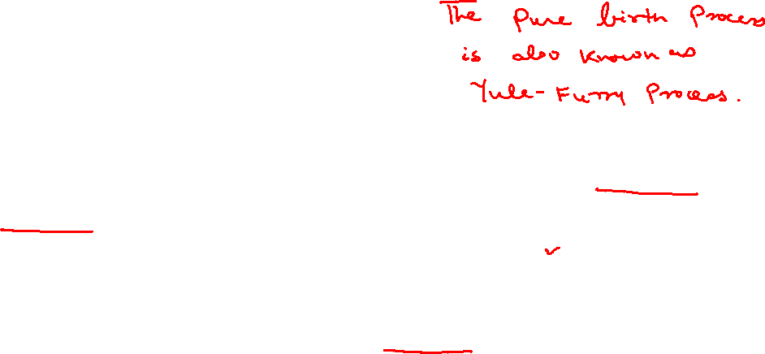
a genus is a low-level taxonomic rank used in the classification of living

Slide 17
If we take k to be a positive integer, we get a special case of gamma probability distribution, known as the Erlang distribution. The difference between Erlang and Gamma is that in a Gamma distribution, k can be a non-integer (positive real number) and in Erlang, k is positive integer only.

Slide 20
Queuing Theory
Queuing theory is a powerful tool to analyze the daily phenomenon of waiting in line.

Slide 21
What is queuing theory?
Queuing theory refers to the mathematical study of the formation and function of waiting lines, or queues.
At its core, a queuing situation involves two parts.
Someone or something that requests a service—usually referred to as the customer, job, or request.
Someone or something that completes or delivers the services—usually referred to as the server.

Slide 22

To illustrate, let’s take two examples. When looking at the queuing situation at a bank, the customers are people seeking to deposit or withdraw money, and the servers are the bank tellers. When looking at the queuing situation of a printer, the customers are the requests that have been sent to the printer, and the server is the printer.

Slide 23
Queuing theory scrutinizes the entire system of waiting in line, including elements like the customer arrival rate, number of servers, number of customers, capacity of the waiting area, average service completion time, and queuing discipline. Queuing discipline refers to the rules of the queue, for example whether it behaves based on a principle of first-in-first-out, last-in-first-out, prioritized, or serve-in-random-order.

Slide 24
Different types of queuing systems
Queuing theory uses the Kendall notation to classify the different types of queuing systems, or nodes. Queuing nodes are classified using the notation A/S/c/K/N/D where:
A is the arrival process
S is the mathematical distribution of the service time
c is the number of servers
K is the capacity of the queue, omitted if unlimited
N is the number of possible customers, omitted if unlimited
D is the queuing discipline, assumed first-in-first-out if omitted

Slide 25

For example, think of an ATM.
It can serve: one customer at a time; in a first-in-first-out order; with a randomly-distributed arrival process and service distribution time; unlimited queue capacity; and unlimited number of possible customers.
Queuing theory would describe this system as a M/M/1 queue (“M” here stands for Markovian, a statistical process to describe randomness).
Queuing theory calculators out there often require choosing a queuing system from the Kendall notation before calculating inputs.

Slide 26
Little’s Law
Little’s Law connects the capacity of a queuing system, the average time spent in the system, and the average arrival rate into the system without knowing any other features of the queue. The formula is quite simple and is written as follows:

Slide 27
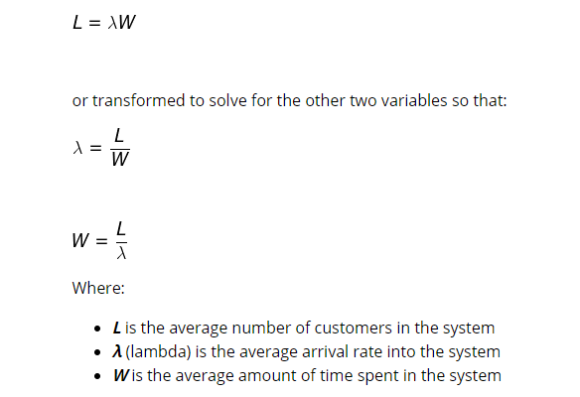

Slide 28
Queuing Notation

Slide 32
M/M/1 Queue
L_{q} is the mean number of customer in the queue.

Slide 35
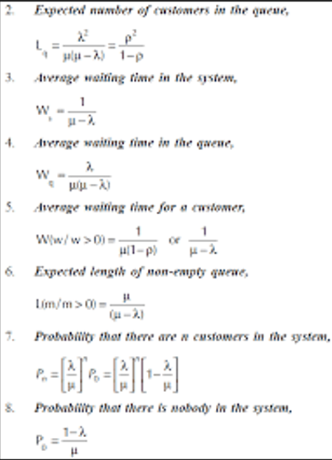

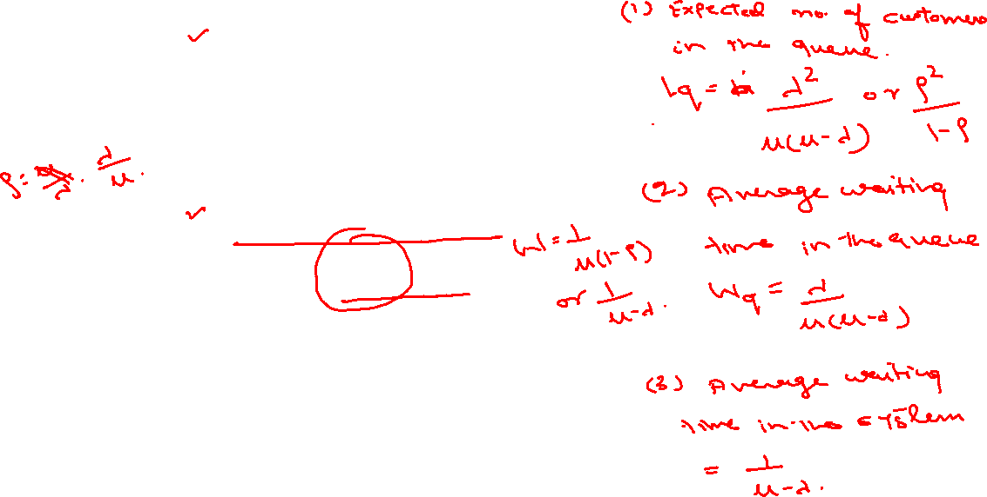

Slide 36
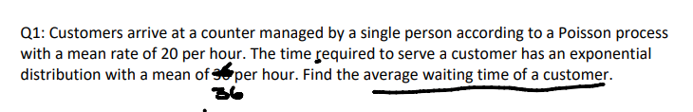

Slide 37
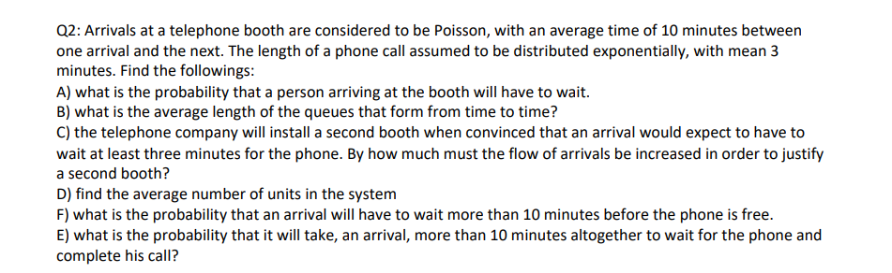

Slide 38
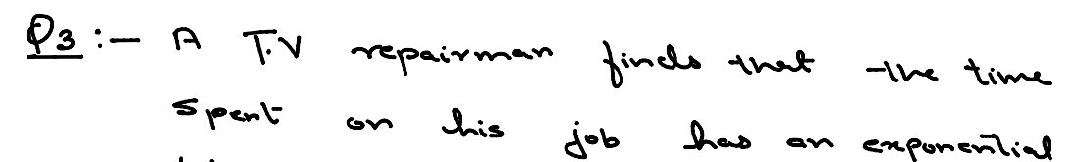
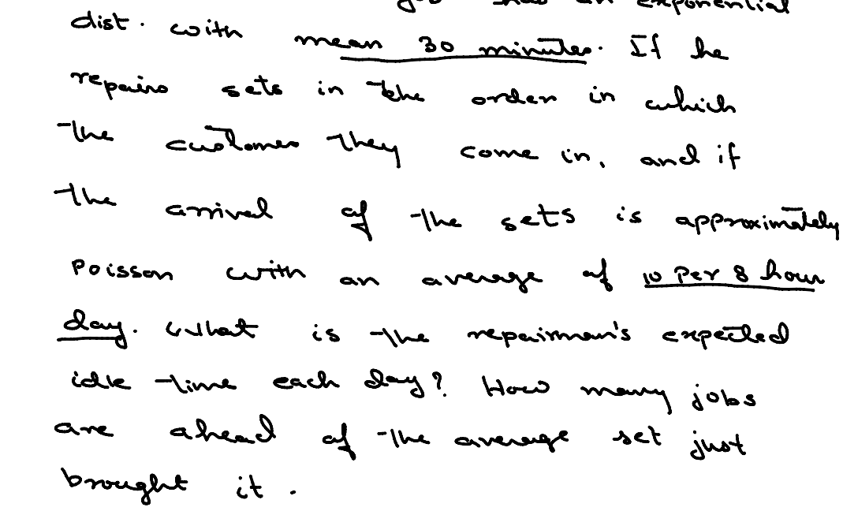

Slide 39
